Slide 1
AI OPTICS:OBJECT RECOGANITION AND CAPTION GENERATION FOR BLINDS USING DEEP LEARNING METHODOLAGIES
MOHAMMED AFNAN PP
MES20MCA-2026
PRODUCT OWNER: MR.VASUDEVAN TV

Slide 2
TABLE OF CONTENTS
Introduction
Modules
Data Flow Diagram
Table Design
Developing Environment
Product Backlog
User Stories
Project Plan
Sprint Plans
Sprint Actual

Slide 3
INTRODUCTION
Millions of people around the world face major disability of visual impairment. Vision provides all the information needed for reading, body movement, mobility and its loss can severely affect an individual’s professional and social advancement. It was reported by the World Health Organization (WHO) that out of 1.3 billion people that suffer from one or another form of visual impairment, 36 million suffer from complete blindness. Problems are often faced by people with impaired vision or complete blindness once they are out of their familiarized environments. Corporeal development is one of the major issues for the people suffering from impaired vision. They also are unable to recognize an object without physically feeling it and can’t savor the beauty of the nature. Many assistive devices have been made commercially available for the visually impaired community of the society to help them read and recognize objects, enhancing their experience. In this paper we propose and end-to-end accessible solution to provide purposeful acknowledgement and guidance using object recognition and caption generation for enabling video to audio aid for the visually impaired community of the society. The aim of purposeful acknowledgement and guidance is to extract the range and direction of the obstacles within a finite and defined free space captured by the camera of the device. The object detection and recognition algorithm will be fed results to the caption generation algorithm for explaining the scene of the surrounding to the visually impaired in audio format

Slide 4
MODULES
Volunteer/ care taker
Signup
Login
View profile, edit , change password
Blind person management(add,edit,view,delete) View emergency help
Sent message to blind
Sent complaints and view reply View location of blind person
Blind person
Authentication check using imei number
Object detection and voice out
Emergency command invocation using voice (sms,web)
Location updation using gps
Video Calling

Slide 5
Methodology

Slide 6
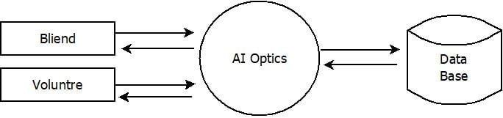
DATA FLOW DIAGRAM
LEVEL 0

Slide 7
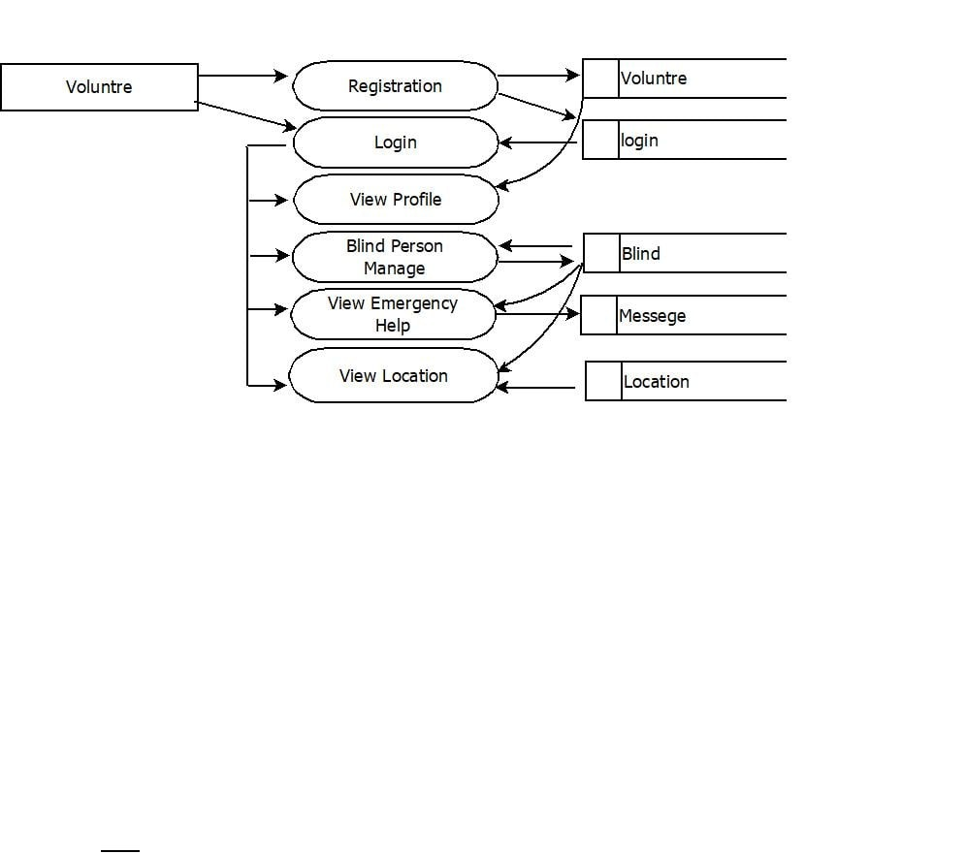
LEVEL 1.1

Slide 8
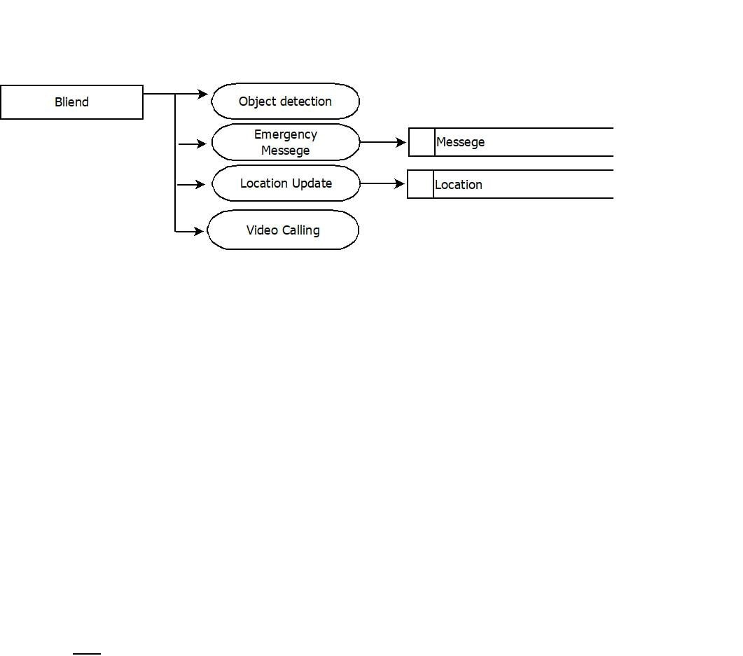
LEVEL 1.2

Slide 9
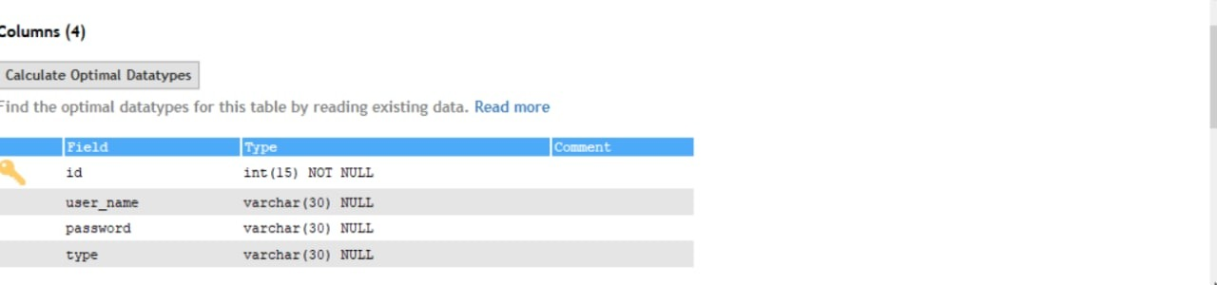
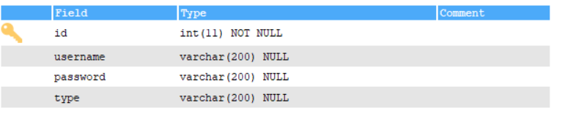
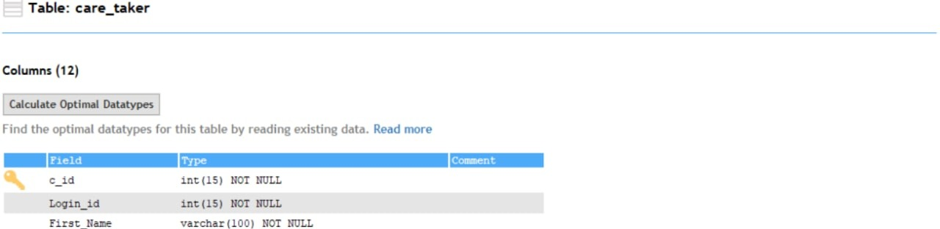
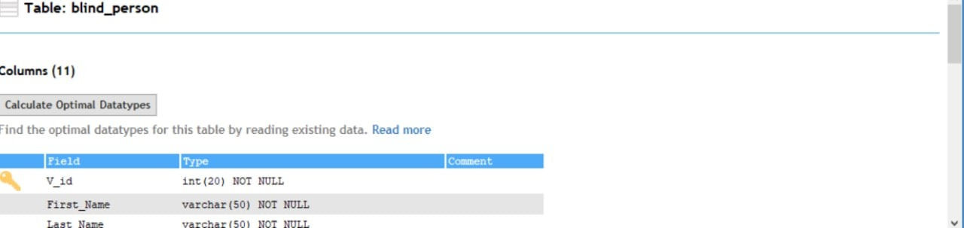
TABLE DESIGN

Slide 10
YOLO Algorithm for Object Detection
YOLO is an algorithm that uses neural networks to provide real-time object detection. This algorithm is popular because of its speed and accuracy. It has been used in various applications to detect traffic signals, people, parking meters, and animals. YOLO is an abbreviation for the term ‘You Only Look Once’. This is an algorithm that detects and recognizes various objects in a picture (in real-time). Object detection in YOLO is done as a regression problem and provides the class probabilities of the detected images.
YOLO algorithm employs convolutional neural networks (CNN) to detect objects in real-time. As the name suggests, the algorithm requires only a single forward propagation through a neural network to detect objects.
This means that prediction in the entire image is done in a single algorithm run. The CNN is used to predict various class probabilities and bounding boxes simultaneously.

Slide 11
Future Enhancements
Relatives(family members) facial recognition
Proposed System
Object detection(identify object and voice out)

Slide 12
DEVELOPING ENVIRONMENT
Processor - intel x86
Speed - 1.1 ghz
RAM – 700 MB (min)
Hard disk - 150 MB
Key board - standard windows keyboard
Mouse - two or three button mouse
Monitor - SVG
Operating system - windows 7 or above ,android
Frontend - HTML, CSS, Python
Backend – mysql
Platform used – pycharm , sqlyog
Web browser - google chrome, fire fox, microsoft edge
Frame work - flask

Slide 13
PRODUCT BACKLOG
User Story ID | Priority <High/Medium/Low> | Size (Hours) | Sprint <#> | Status <Planned/In progress/Completed> | Release Date | Release Goal
1 | Medium | 2 | 1 | Completed |  | Table design
2 | High | 3 |  | Completed |  | Form design
3 | High | 5 |  | Completed |  | Basic coding
3 | High | 5 | 2 | Completed |  | Creation data set
4 | Medium | 5 |  | Completed |  | Preprocessing
5 | High | 5 | 3 | Completed |  | Training
6 | medium | 5 |  | Completed |  | Voice Alert
7 | Medium | 5 | 4 | Completed |  | Testing data
8 | High | 5 |  | Completed |  | Output generation

Slide 14
USER STORIES
UserStoryID | As a <type of user> | I want to | So that I can
1 | Table design | Design tables for project | Create tables with normalization
2 | Form design | Complete form design | Complete form designs for our project
3 | Linking | Load and link html pages | Complete load and link
4 | Volunteer | login | login successful with correct username and password
5 | Volunteer | Update Profile | View and update all the personal details.
6 | Volunteer | View emergency help | view blind persons emergency help and track the current location.

Slide 15
PROJECT PLAN
User story ID | Task name | Start date | End date | Days | Status
Sprint1
1 | UI designing | 27/11/2021 | 30/11/2021 | 3 | Completed
2 | Database connectivity | 18/12/2021 | 20/12/2021 | 2 | Completed
3 | Coding | 04/01/2022 | 08/01/2022 | 5 | Completed
Sprint2
4 | UI designing | 13/01/2022 | 16/01/2022 | 3 | Completed
5 | Database connectivity | 10/01/2022 | 14/01/2022 | 4 | Completed
6 | Coding | 27/01/2022 | 31/01/2022 | 5 | Completed

Slide 16
User story ID | Task name | Start date | End date | Days | Status
Sprint3
7 | UI designing | 02/02/2022 | 05/02/2022 | 3 | Completed
8 | Database connectivity | 06/02/2022 | 08/02/2022 | 2 | Completed
9 | Coding | 10/02/2022 | 15/02/2022 | 5 | Completed
10 | Testing & validation | 16/02/2022 | 17/02/2022 | 1 | Completed
Sprint4
11 | UI designing | 18/02/2022 | 20/02/2022 | 2 | Completed
12 | Database connectivity | 20/02/2022 | 21/02/2022 | 1 | Completed
13 | Coding | 20/02/2022 | 23/02/2022 | 5 | Completed

Slide 17
SPRINT BACKLOG PLAN
Backlog Item | Status & completion date | Original estimate in hours | Day1 | Day2 | Day3 | Day4 | Day5 | Day6 | Day7 | Day8 | Day9 | Day10 | Day11 | Day12 | Day13 | Day14
User story #1,#2,#3,#4 |  | hrs | hrs | hrs | hrs | hrs | hrs | hrs | hrs | hrs | hrs | hrs | hrs | hrs | hrs | hrs
Volunteer registration form | 20/01/2022 | 5 | 1 | 1 | 0 | 0 | 0 | 0 | 0 | 1 | 0 | 0 | 1 | 0 | 0 | 1
Volunteer Login form | 28/01/2022 | 5 | 0 | 0 | 0 | 1 | 1 | 1 | 0 | 0 | 0 | 0 | 0 | 1 | 0 | 1
Home page | 03/02/2022 | 5 | 0 | 0 | 0 | 0 | 0 | 0 | 0 | 0 | 0 | 1 | 1 | 1 | 1 | 1
Volunteer | 05/02/2022 | 5 | 0 | 0 | 0 | 0 | 0 | 0 | 0 | 0 | 0 | 1 | 1 | 1 | 1 | 1
Database operations | 08/02/2022 | 5 | 1 | 1 | 1 | 1 | 1 | 0 | 0 | 0 | 0 | 0 | 0 | 0 | 0 | 0
Database operations for caretaker booking | 12/02/2022 | 5 | 0 | 0 | 0 | 0 | 0 | 0 | 0 | 1 | 0 | 1 | 1 | 1 | 0 | 1
Testing | 14/02/2022 | 5 | 0 | 1 | 0 | 0 | 1 | 0 | 0 | 1 | 0 | 0 | 1 | 0 | 0 | 1
Output generation | 20/02/2022 | 5 | 0 | 0 | 0 | 0 | 0 | 0 | 0 | 0 | 0 | 2 | 1 | 1 | 1 | 1
Total |  | 40 | 4 | 4 | 2 | 4 | 3 | 2 | 0 | 2 | 0 | 5 | 4 | 4 | 3 | 4

Slide 18
SPRINT ACTUAL
Backlog Item | Status & completion date | Original estimate in hours | Day1 | Day2 | Day3 | Day4 | Day5 | Day6 | Day7 | Day8 | Day9 | Day10 | Day11 | Day12 | Day13 | Day14
User story #1,#2,#3,#4 |  | hrs | hrs | hrs | hrs | hrs | hrs | hrs | hrs | hrs | hrs | hrs | hrs | hrs | hrs | hrs
Volunteer registration | 20/01/2022 | 5 | 1 | 1 | 0 | 0 | 0 | 0 | 0 | 0 | 1 | 0 | 0 | 1 | 0 | 1
Volunteer Login form | 28/01/2022 | 2 | 0 | 0 | 0 | 1 | 1 | 1 | 0 | 0 | 0 | 0 | 0 | 0 | 0 | 0
Home page | 03/02/2022 | 5 | 0 | 0 | 0 | 0 | 0 | 0 | 0 | 0 | 0 | 1 | 1 | 1 | 1 | 1
Basic coding | 08/02/2022 | 5 | 1 | 0 | 1 | 0 | 1 | 0 | 1 | 0 | 0 | 0 | 0 | 0 | 0 | 0
Caretaker Dataset | 11/02/2022 | 3 | 1 | 0 | 0 | 0 | 1 | 0 | 0 | 0 | 0 | 1 | 0 | 0 | 0 | 0
Data Base operation | 13/02/2022 | 5 | 1 | 0 | 0 | 1 | 0 | 0 | 0 | 1 | 0 | 0 | 1 | 0 | 0 | 1
Training | 15/02/2022 | 5 | 1 | 0 | 1 | 1 | 0 | 0 | 0 | 1 | 0 | 0 | 0 | 0 | 1 | 0
Testing | 18/02//2022 | 5 | 0 | 1 | 0 | 0 | 1 | 0 | 1 | 0 | 0 | 1 | 0 | 1 | 0 | 0
Output generation | 20/02/2022 | 5 | 0 | 0 | 1 | 1 | 0 | 0 | 0 | 1 | 0 | 1 | 0 | 0 | 1 | 0
Total |  | 40 | 1 | 1 | 0 | 1 | 1 | 1 | 0 | 0 | 0 | 1 | 1 | 1 | 1 | 1

Slide 19
THANK YOU

